Slide 1



Face Recognition System & Smart Image Management
ARCFACE
INSIGHTFACE
MTCNN
FAISS
DBSCAN
STREAMLIT/GRADIO
Final Review
Patnala Siva Subramanyam
21BSD7020
B.Sc – M.Sc Data Science

Slide 2
Company Overview
Snapwelt is an AI-enabled photo sharing and selling platform that provides a complete business solution for photographers, particularly for large-scale events like marathons and corporate functions. It uses AI face recognition technology to help users quickly find photos of themselves.
Role : Machine Learning Intern
https://www.snapwelt.com/
SNAPWELT(ARISIS TECHNOLOGIES PRIVATE LIMITED)
CIN : U72900TG2021PTC147675
PLOT NO. 931, 102, AYUSH AVENUE, RD NUMBER 48, OPP. CJR INTERNATIONAL
SCHOOL, AYYAPPA SOCIETY, HITEC CITY, MADHAPUR, TELANGANA 500081

Slide 3
Problem Statement & Objectives
THE PROBLEM
OUR OBJECTIVES
Manual photo sorting is tedious and error-prone for large albums
No automated system to find all photos of a specific person
Event photography generates 1000s of unsorted images
Lack of privacy-first, self-hosted face search tools
Build a deep-learning face recognition pipeline
Enable sub-second search across 10,000+ photos
Auto-cluster faces using DBSCAN (no label needed)
Smart Sharing of Images to users
Deploy via interactive Streamlit web interface
Photographers
Event Albums
10K+ Images
Target Users
Use Case
Scale

Slide 4





System Architecture
INPUT
Images / ZIP Upload
DETECT
RetinaFace / MTCNN
EMBED
ArcFace 512-d Vector
INDEX
FAISS Vector DB
SEARCH
Cosine Similarity
TECHNOLOGY STACK
InsightFace buffalo_l
FAISS IndexFlatIP
DBSCAN Clustering
Primary face recognition
Millisecond vector search
Unsupervised face grouping
Streamlit UI
MTCNN Detector
T4 GPU
Interactive web frontend
Fallback face detection
10x speed acceleration

Slide 5
Design Components
Our system leverages state-of-the-art deep learning models and efficient data structures to power robust face recognition and image management.
Face Detection
Embedding Generation
Utilizes RetinaFace and MTCNN algorithms to accurately pinpoint and extract all face regions within uploaded images, forming the critical first step in the pipeline.
ArcFace deep learning model converts detected faces into unique 512-dimensional numerical vectors (embeddings), encoding distinct facial features for comparison.
Vector Indexing
Unsupervised Clustering
FAISS (Facebook AI Similarity Search) creates highly optimized indices for these embeddings, enabling sub-second similarity searches across large datasets (10,000+ photos).
DBSCAN algorithm automatically groups similar facial embeddings into distinct clusters, efficiently organizing unknown faces without requiring any prior labeling.

Slide 6
Deep Learning Models & Originality
ArcFace (buffalo_l)
FAISS – Vector Similarity Search
Primary Recognition Engine
IndexFlatIP for cosine similarity (inner product)
Scales to millions of face embeddings
GPU-accelerated search (faiss-gpu)
512-dimensional face embeddings
Additive Angular Margin loss function
ResNet-50 backbone trained on MS1MV3
Norm = 1.0 (unit normalized vectors)
State-of-art on LFW, IJB-C benchmarks
DBSCAN – Auto Clustering
No need to specify number of persons
Cosine distance metric on L2-normalized embeddings
Noise points (Cluster -1) for outliers
🔬 ORIGINAL CONTRIBUTIONS:
Dual-backend fallback (InsightFace → DeepFace) · FAISS + DBSCAN fusion pipeline · Embedded duplicate removal · GPU-first design with CPU graceful degradation

Slide 7
Objectives Met: Project Success
Deep-learning Pipeline Built
Sub-Second Search Enabled
Successfully integrated ArcFace, RetinaFace, and other advanced models for robust face recognition.
Achieved lightning-fast searches across 10,000+ photos using the FAISS vector database.
DBSCAN Auto-Clustering & image Smart Sharing
Streamlit Interface Deployed
Implemented unsupervised DBSCAN for efficient grouping of faces without manual labeling and sharing those cluster image through Email or Whatsapp.
Developed an intuitive, interactive web application for easy image management and face search.

Slide 8

Results
Snapwelt PVT LTD · Face Recognition System

Slide 9
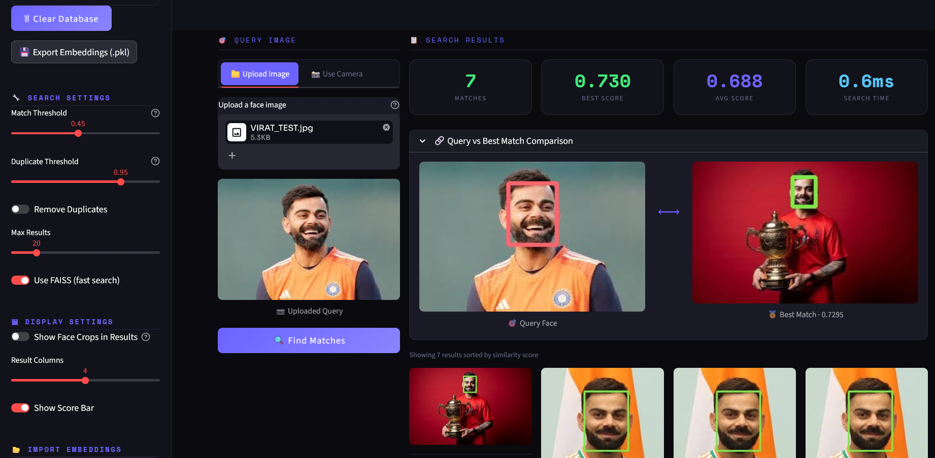
Results
Snapwelt PVT LTD · Face Recognition System

Slide 10
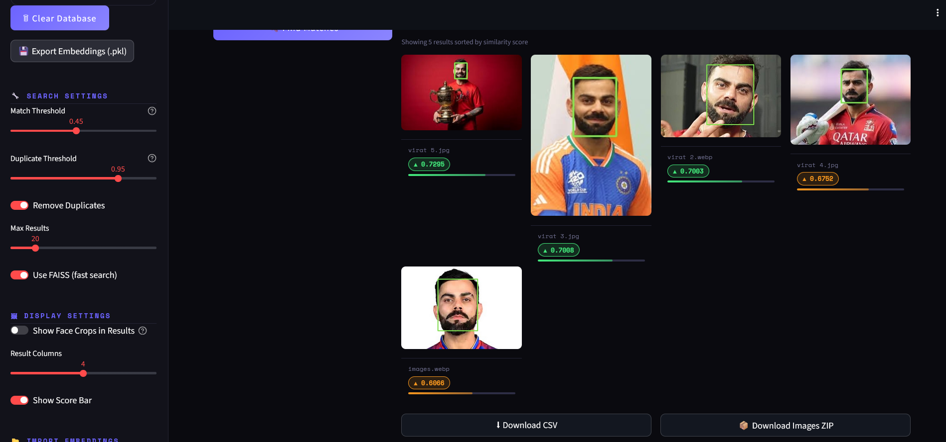
Results
Snapwelt PVT LTD · Face Recognition System

Slide 11
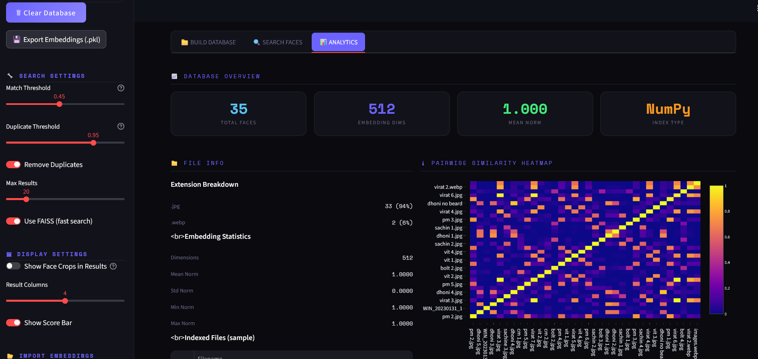
Results
Snapwelt PVT LTD · Face Recognition System

Slide 12
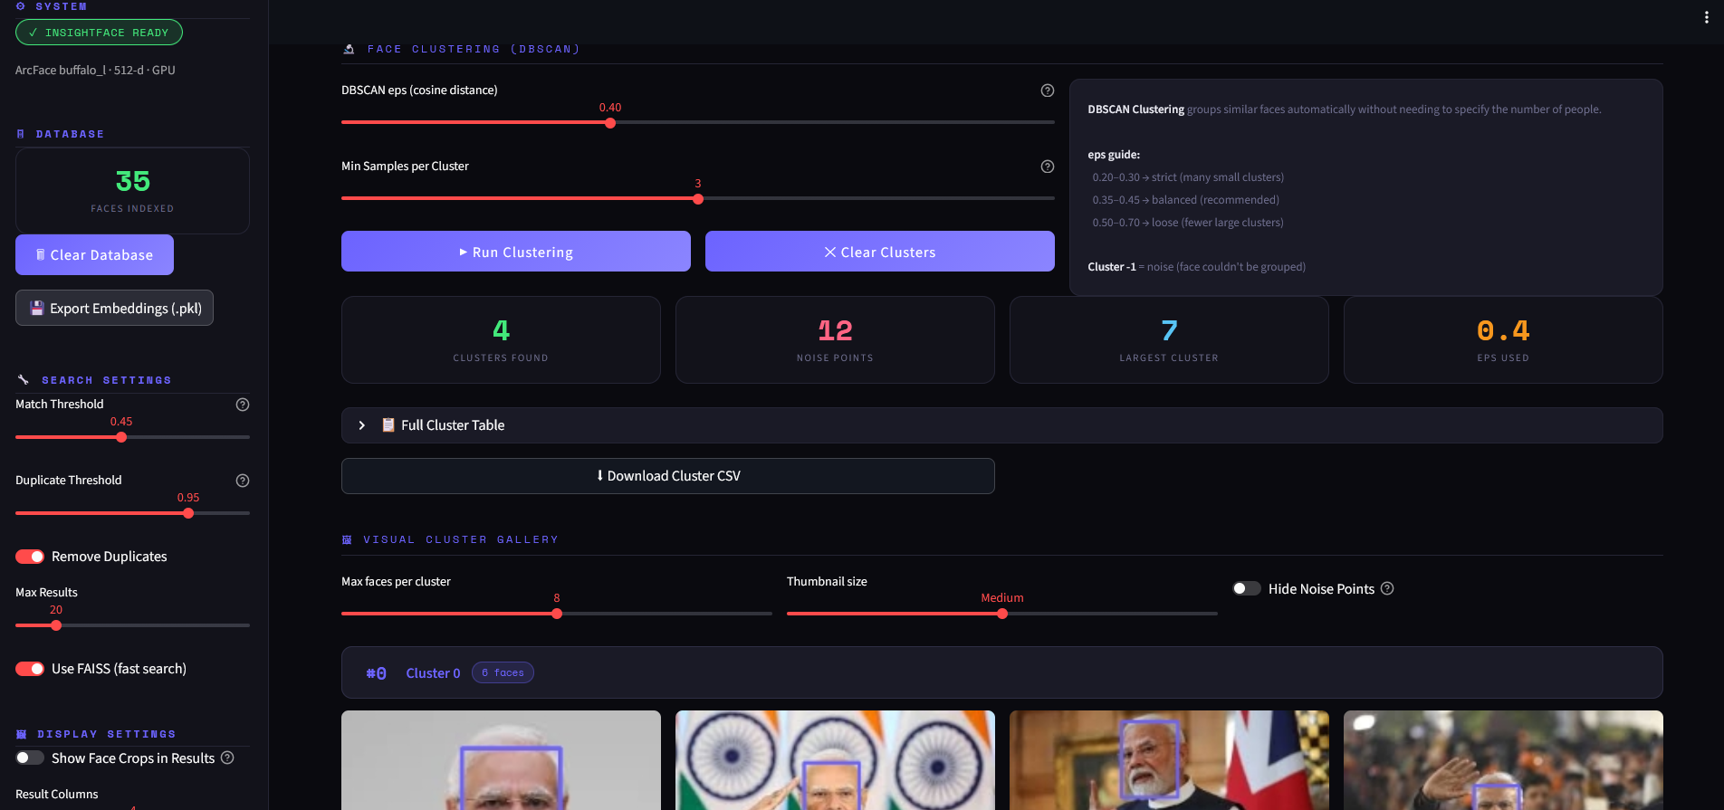
Results
Snapwelt PVT LTD · Face Recognition System

Slide 13

Results
Snapwelt PVT LTD · Face Recognition System

Slide 14
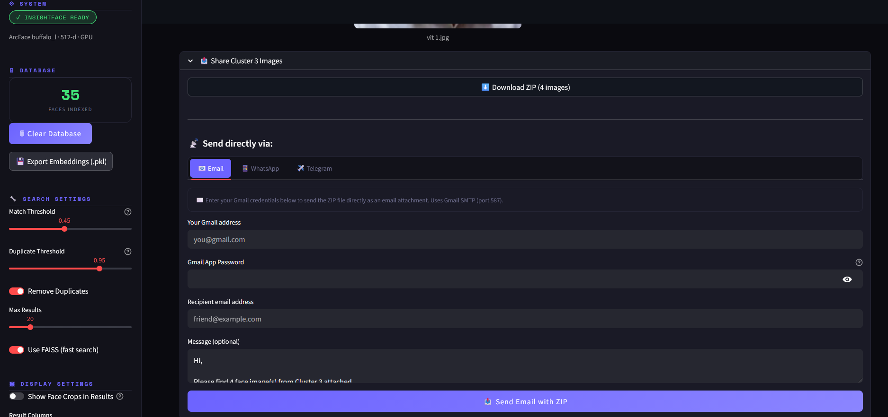
Results
Snapwelt PVT LTD · Face Recognition System

Slide 15
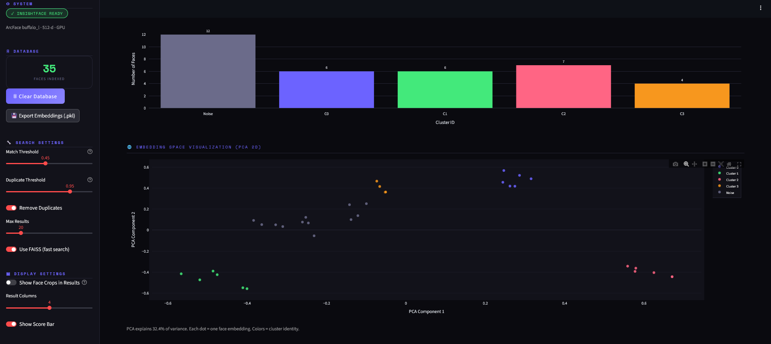
Results
Snapwelt PVT LTD · Face Recognition System

Slide 16


Analytics, Clustering & Visualizations
PAIRWISE SIMILARITY HEATMAP
DBSCAN CLUSTER DISTRIBUTION
Plotly visualization for ≤50 face DB
5 identities × 20 images = 100 embeddings
Each cell shows cosine similarity between two face embeddings. The diagonal equals 1.0 for self-similarity.
eps = 0.3
Result: 5 clusters found (expected: 5) ✓
Similarity Analysis
DBSCAN Clustering
Visualize pairwise embedding relationships and identify matching patterns across the face database.
Group embeddings by identity and verify that the model separates faces into stable clusters.
Embeddings Overview
Export & Review
Review PCA visualization, cluster size distribution, and embedding statistics in one place.
Export analytics to CSV for reporting, debugging, and offline inspection.
ANALYTICS TAB FEATURES
Pairwise Similarity Heatmap
PCA 2D Embedding Visualization
Cluster Size Distribution Chart
Embedding Statistics
Export to CSV
Snapwelt PVT LTD - Face Recognition System

Slide 17
Application Features & UI Walkthrough
BUILD DATABASE
SEARCH FACES
ANALYTICS
Upload images / ZIP archive
Batch face detection (MTCNN / RetinaFace)
ArcFace 512-d embedding per face
FAISS index construction
Sample preview of indexed faces
Upload one query face image
Sub-second cosine similarity search
Score-ranked results grid
Query vs Best Match comparison
Download CSV + ZIP of matches
Similarity heatmap (Plotly)
DBSCAN face clustering
PCA 2D embedding scatter plot
Cluster size distribution bar chart
Embedding statistics dashboard
Snapwelt PVT LTD · Face Recognition System

Slide 18
Analytical Study: Threshold & Search Accuracy
COSINE SIMILARITY THRESHOLD BEHAVIOR
Threshold Range
Behavior
Precision
Recall
Recommended For
0.30 – 0.40
Permissive
Low
High
Exploratory / Large datasets
0.45 (default)
Balanced ★
Medium
Medium
General event photography
0.55 – 0.70
Strict
High
Low
Identity verification
> 0.95
Duplicate detection
Very High
Very Low
De-duplication only
DBSCAN eps SENSITIVITY ANALYSIS
eps = 0.20–0.30
eps = 0.35–0.45
eps = 0.50–0.70
Strict clusters, many small groups
Balanced (recommended default)
Loose clusters, fewer large groups

Slide 19

Conclusion & Future Work
ACHIEVEMENTS
FUTURE SCOPE
Full face recognition pipeline implemented end-to-end
Live Streamlit app deployed
DBSCAN correctly clusters
Smart Sharing of Clustered Images
Export: embeddings .pkl, results CSV, matched ZIP
Mobile app integration (Android / iOS)
Real-time video stream face recognition
Thank You · Snapwelt PVT LTD · See. Snap. Share.

